Slide 1
COMP 51 Week Two
C++ Basics
Variables
Console I/O

Slide 2
What are we Talking About
Variables, Expressions, and Assignment Statements
Console Input/Output
Output Formatting

Slide 3
Why Do We Care?
All programs have some kind of input and output. Sometimes it’s called GIGO
Programs process information
how is data stored?
Saving information

Slide 4
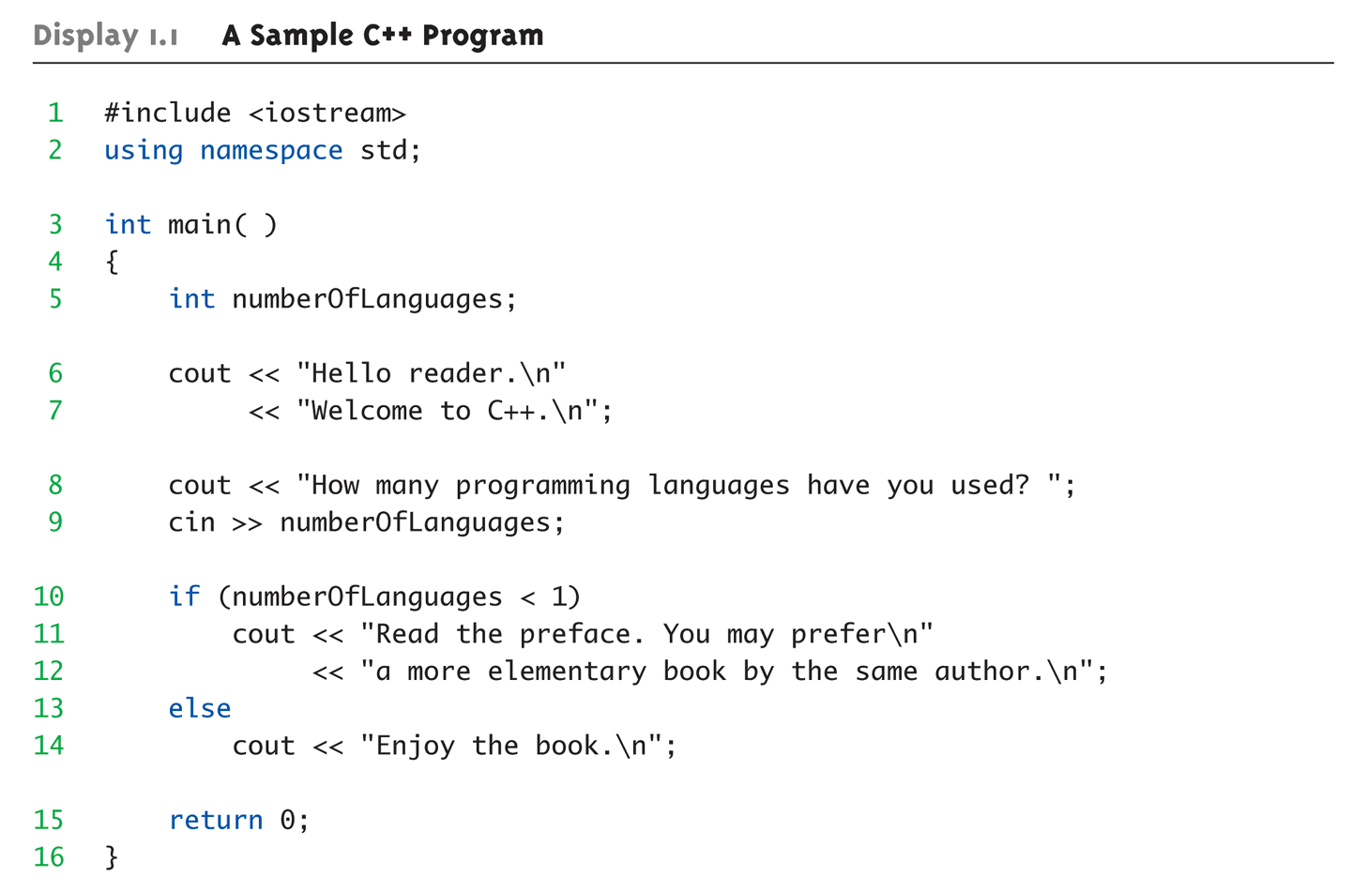
Review of Sample Program A Sample C++ Program (1 of 2)
Notes:
Using namespace std; is used so we don’t need to add std:: in front of every line. Otherwise, etc, std::cout << “Hello World”;

Slide 5
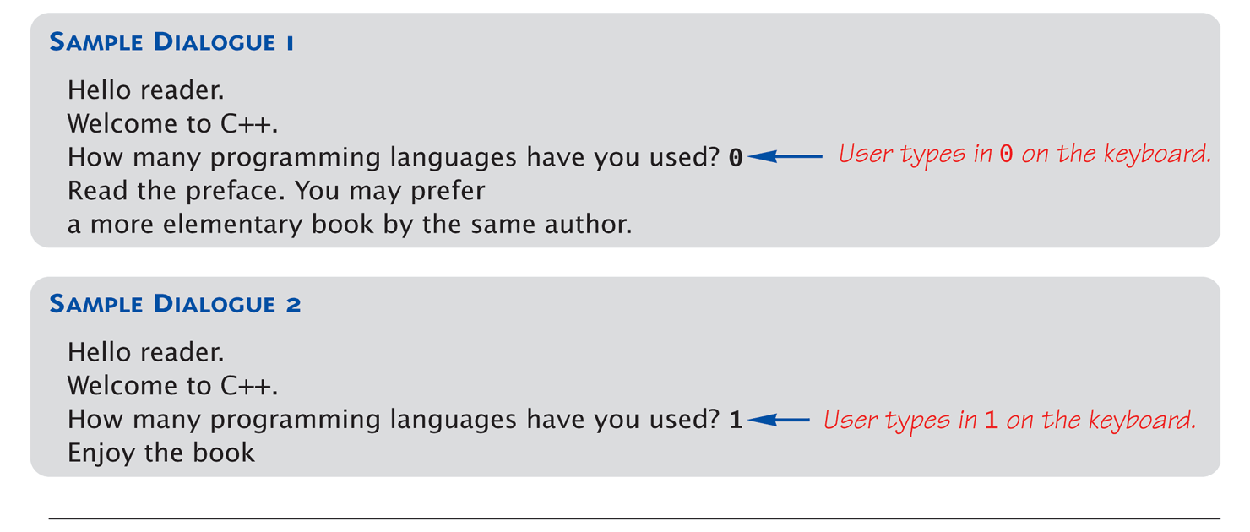
Display 1.1 A Sample C++ Program (2 of 2)

Slide 6
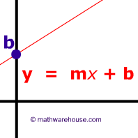
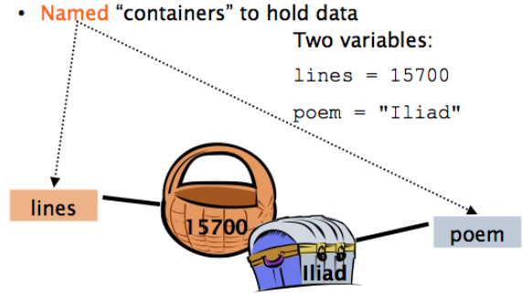
Getting Variables
Back to Math – What is the variable in this equation
Variables hold values

Slide 7
C++ Variables
C++ Identifiers
Keywords/reserved words vs. Identifiers
Case-sensitivity and validity of identifiers
Use Meaningful names!
Variables
A memory location to store data for a program
Must declare all data before use in program

Slide 8
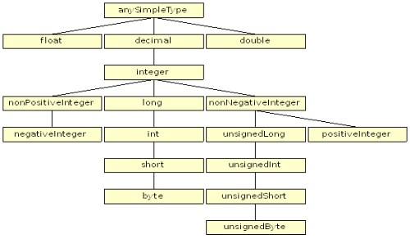
Basic Data Type Tree
Notes:
Boolean, true or false – bool true;

Slide 9
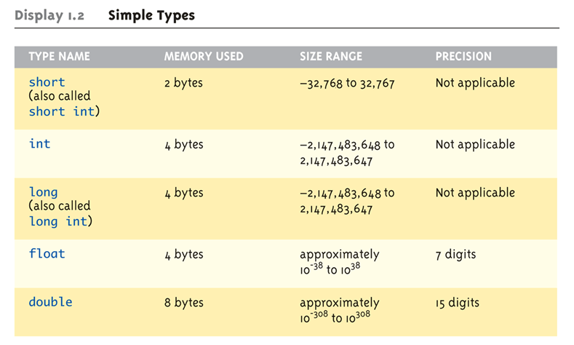
Simple Data Types (1 of 2)
Why is this important? Gangnam Style – That’s Why!!!

Slide 10
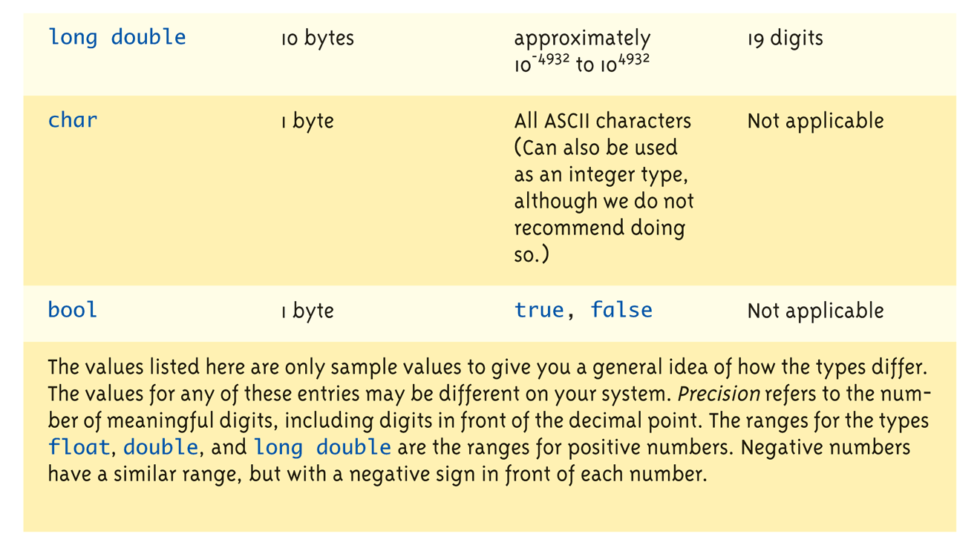
Simple Data Types (2 of 2)

Slide 11
Assigning Data
Initializing data in declaration statement
Results "undefined" if you don’t!
int myValue = 0;
Assigning data during execution
Lvalues (left-side) & Rvalues (right-side)
Lvalues must be variables
Rvalues can be any expression
Example: distance = rate * time; Lvalue: "distance" Rvalue: "rate * time"

Slide 12
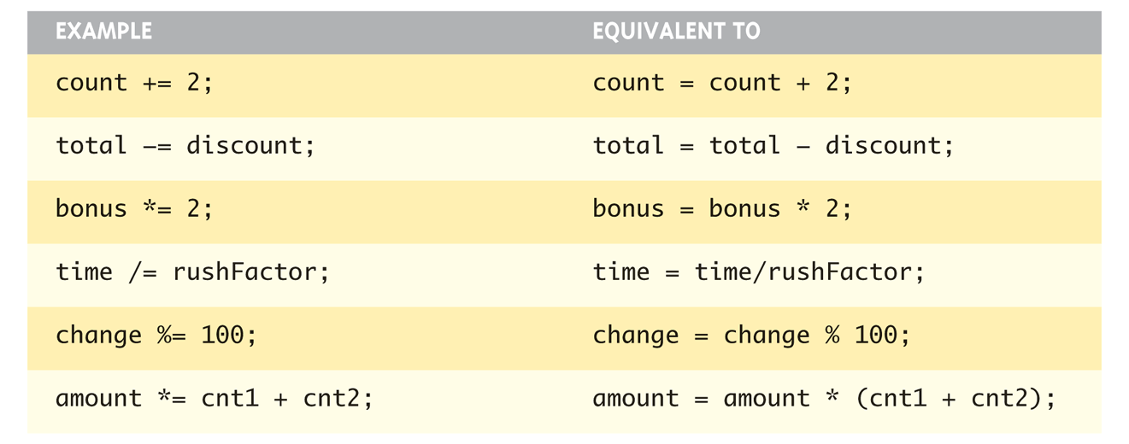
Assigning Data: Shorthand Notations
Display, page 14

Slide 13
Data Assignment Rules
Compatibility of Data Assignments
Type mismatches
General Rule: Cannot place value of one type into variable of another type
intVar = 2.99; // 2 is assigned to intVar!
Only integer part "fits", so that’s all that goes
Called "implicit" or "automatic type conversion"
Literals
2, 5.75, "Z", "Hello World"
Considered "constants": can’t change in program
Notes:
If put float value into integer, integer gets rid of decimal points without rounding

Slide 14

Literal Data or Constants
Literals
Examples:
2 // Literal constant int
5.75 // Literal constant double
"Z" // Literal constant char
"Hello World" // Literal constant string
Escape Sequences
"Extend" character set
Backslash, \ preceding a character
Instructs compiler: a special "escape character" is coming
Following character treated as "escape sequence char"
Notes:
Cannot change values during execution
Called "literals" because you "literally typed" them in your program!

Slide 15
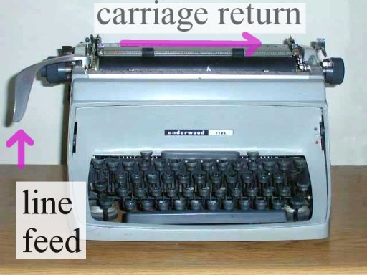
Most Commonly Used - NewLine
\n

Slide 16
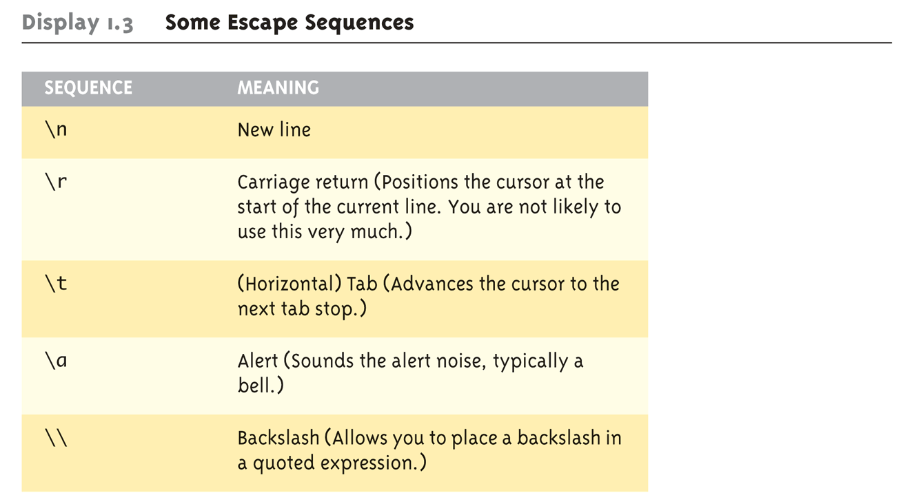
Display 1.3 Some Escape Sequences (1 of 2)

Slide 17
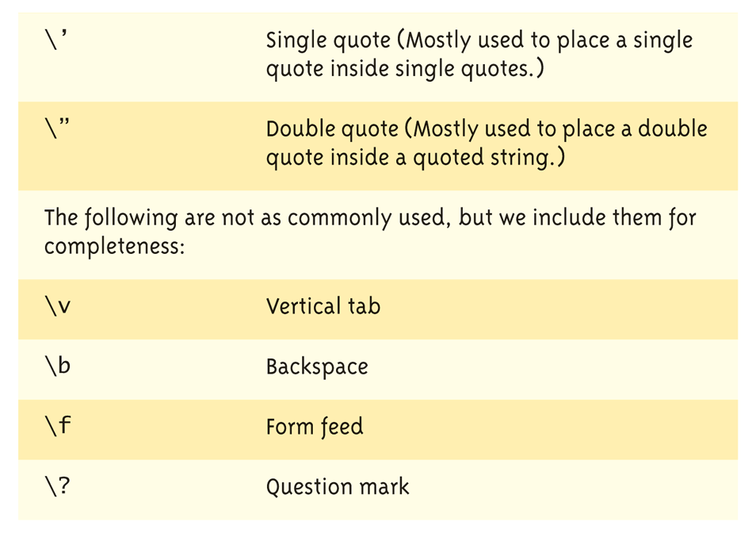
Display 1.3 Some Escape Sequences (2 of 2)

Slide 18
Naming Constants
What could the following mean?
Int h = 24 * 365;
How could this be better written?
Notes:
Use named constants instead
Meaningful name to represent data const int NUMBER_OF_STUDENTS = 24;
Called a "declared constant" or "named constant"
Now use it’s name wherever needed in program
Added benefit: changes to value result in one fix
Use const because h doesn’t need to be updated and this prevents accidental updates

Slide 19
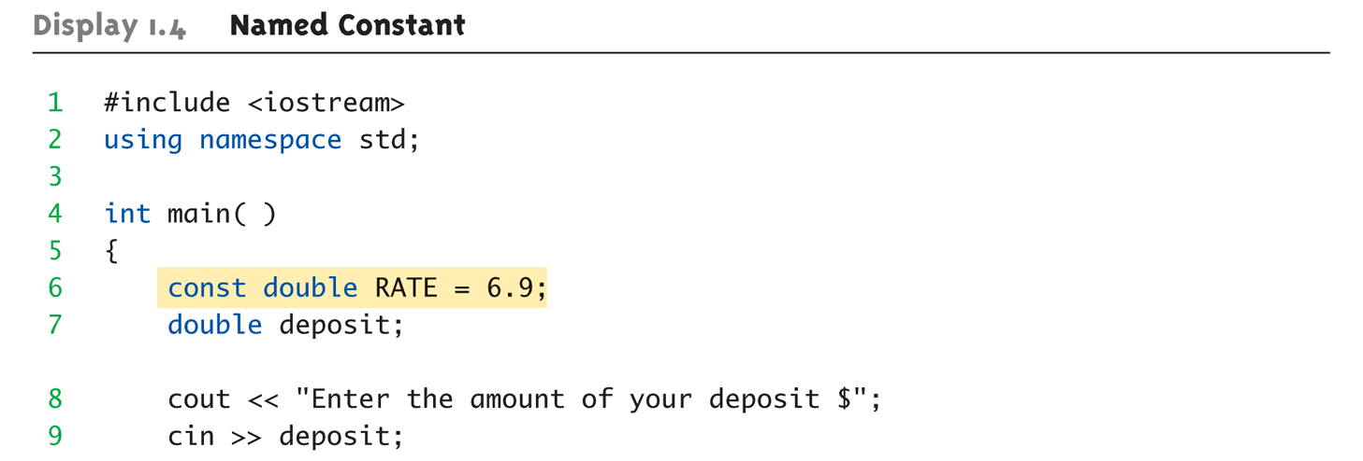
Arithmetic Operators: Display 1.4 Named Constant (1 of 2)
Standard Arithmetic Operators
Precedence rules – standard rules

Slide 20
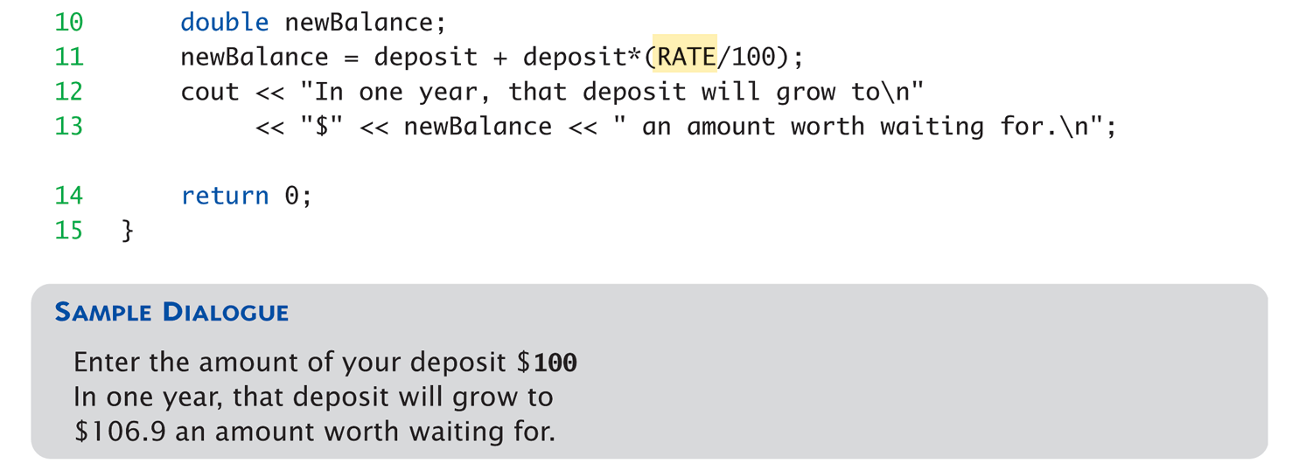
Math Revisited - Precedence
What does PEMDAS stand for
Quick math : (100 + .08) * 10² =
Code Example
Notes:
PEMDAS – parentheses, exponents, multiplication/division, addition/subtraction.

Slide 21
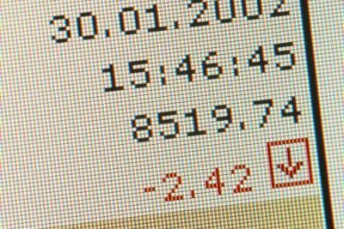
Arithmetic Precision
Precision of Calculations
VERY important consideration!
Expressions in C++ might not evaluate as you’d "expect"!
"Highest-order operand" determines type of arithmetic "precision" performed
Common pitfall!

Slide 22
Arithmetic Precision Examples
17 / 5 = ?
17.0 / 5 = ?
1 / 2 / 3.0 / 4 = ?
C++ Variables
Int i = 1, j = 2;
i/j = ?
Notes:
17 / 5 evaluates to 3 in C++!
Both operands are integers
Integer division is performed!
17.0 / 5 equals 3.4 in C++!
Highest-order operand is "double type"
Double "precision" division is performed!
int intVar1 =1, intVar2=2; intVar1 / intVar2;
Performs integer division!
Result: 0!
Calculations done "one-by-one"
1 / 2 / 3.0 / 4 performs 3 separate divisions.
First→ 1 / 2 equals 0
Then→ 0 / 3.0 equals 0.0
Then→ 0.0 / 4 equals 0.0!
So not necessarily sufficient to change just "one operand" in a large expression
Must keep in mind all individual calculations that will be performed during evaluation!

Slide 23

Type Casting Types
Implicit—also called "Automatic“ – done FOR you
Done FOR you, automatically 17 / 5.5 = 17.0 / 5.5 = 3.1
Explicit type conversion
Programmer specifies conversion with cast operator (double)17 / 5.5 = 3.1
Notes:
Can add ".0" to literals to force precision arithmetic, but what about variables?
We can’t use "myInt.0"!
static_cast<double>intVar
Explicitly "casts" or "converts" intVar to double type
Result of conversion is then used
Example expression: doubleVar = static_cast<double>intVar1 / intVar2;
Casting forces double-precision division to take place among two integer variables!

Slide 24

Shorthand Operators
Increment & Decrement Operators
Just short-hand notation
Increment operator, ++ intVar++; is equivalent to intVar = intVar + 1;
Decrement operator, -- intVar--; is equivalent to intVar = intVar – 1;

Slide 25
Shorthand Examples Examples
Post-Increment in Expressions: int n = 2, valueProduced; valueProduced = 2 * (n++);
What is valueProduced? n?
Pre-Increment
int n = 2, valueProduced; valueProduced = 2 * (++n);
Now what do they equal?
Notes:
Post-Increment intVar++
Uses current value of variable, THEN increments it
Pre-Increment ++intVar
Increments variable first, THEN uses new value
"Use" is defined as whatever "context" variable is currently in
No difference if "alone" in statement: intVar++; and ++intVar; → identical result
cout << valueProduced << endl; cout << n << endl;
This code segment produces the output: 4 3
Since post-increment was used

Slide 26
Pre-Increment in Action
Now using Pre-increment: int n = 2, valueProduced; valueProduced = 2 * (++n); cout << valueProduced << endl; cout << n << endl;
This code segment produces the output: 6 3
Because pre-increment was used

Slide 27
What are we Talking About
Variables, Expressions, and Assignment Statements
Console Input/Output
Output Formatting
Notes:
End of Lecture One

Slide 28

Console Input/Output
Three I/O objects : cin, cout, cerr
Defined in the C++ library called <iostream>
Must add these lines (called pre- processor directives) at top:
#include <iostream> using namespace std;
Notes:
Tells C++ to use appropriate library so we can use the I/O objects cin, cout, cerr

Slide 29
Console Output
Any data can be outputted to display screen
Variables
Constants
Literals
Expressions (which can include all of above)
cout << numberOfGames << " games played."; 2 values are outputted: "value" of variable numberOfGames, literal string " games played."
Cascading: multiple values in one cout

Slide 30
Separating Lines of Output
New lines in output
Recall: "\n" is escape sequence for the char "newline"
A second method: object endl
Examples:
cout << "Hello World\n";
Sends string "Hello World" to display, & escape sequence "\n", skipping to next line
cout << "Hello World" << endl;
Same result as above

Slide 31
Simple Input Using cin
CIN should be preceded by a COUT prompt. Tell the user what to do.
cin >> num;
Waits on-screen for keyboard entry
Value entered at keyboard is "assigned" to num
CIN is very simple, does not parse data, spaces end up as two inputs
Notes:
Differences:
">>" (extraction operator) points opposite
Think of it as "pointing toward where the data goes"
Object name "cin" used instead of "cout"
No literals allowed for cin
Must input "to a variable"
Always "prompt" user for input cout << "Enter number of dragons: "; cin >> numOfDragons;
Note no "\n" in cout. Prompt "waits" on same line for keyboard input as follows:
Enter number of dragons: ____
Underscore above denotes where keyboard entry is made
Every cin should have cout prompt
Maximizes user-friendly input/output

Slide 32
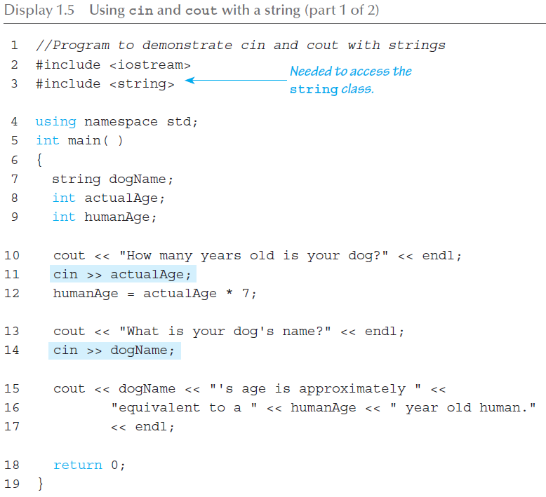
Input/Output (1 of 2)
Notes:
C++ has a data type of “string” to store sequences of characters
Not a primitive data type; distinction will be made later
Must add #include <string> at the top of the program
The “+” operator on strings concatenates two strings together
cin >> str where str is a string only reads up to the first whitespace character

Slide 33
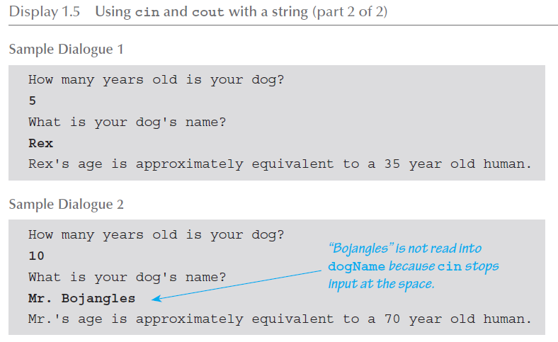
Input/Output (2 of 2)

Slide 34
Formatting Output
What does this code generate?
cout << "The price is $" << price << endl;
We must explicitly tell C++ how to output numbers in our programs!
Notes:
Formatting numeric values for output
Values may not display as you’d expect! cout << "The price is $" << price << endl;
If price (declared double) has value 78.5, you might get:
The price is $78.500000 or:
The price is $78.5

Slide 35
Formatting Numbers
"Magic Formula" to force decimal sizes: cout.setf(ios::fixed); cout.setf(ios::showpoint); cout.precision(2);
:: Is used to scope to reference to the ios object
Notes:
These stmts force all future cout’ed values:
To have exactly two digits after the decimal place
Example: cout << "The price is $" << price << endl;
Now results in the following: The price is $78.50
Can modify precision "as you go" as well!

Slide 36
Error Output
Program
Input
Output
Errors
Why – Because sometimes users do stupid things!
Output with cerr works same as cout
Notes:
Provides mechanism for distinguishing between regular output and error output
Re-direct output streams
Most systems allow cout and cerr to be "redirected" to other devices
e.g., line printer, output file, error console, etc.

Slide 37
Key Takeaways
C++ is case-sensitive
Variables
Use meaningful names for variables & constants
Variables must be declared before use
Should be initialized
Cin, cout, cerr
What are these used for?
Remember basic math precedence

